Slide 1



简单高效LaTeX Simple & Effective LaTeX
001 – 开篇和实践介绍 Opening
- GitHub address: https://github.com/yasenstar/learn_latex
- Gitee address: https://gitee.com/yasenstar/learn_latex

Slide 2
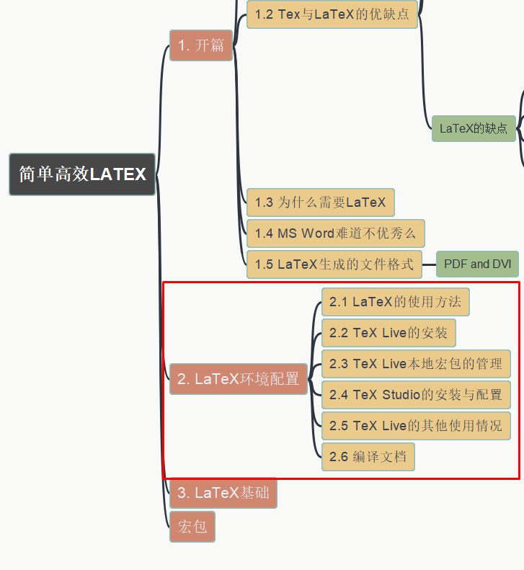
简单高效LaTeX Simple & Effective LaTeX
002 – LaTeX的环境配置
LaTeX Editing Environment Setup
- GitHub address: https://github.com/yasenstar/learn_latex
- Gitee address: https://gitee.com/yasenstar/learn_latex

